Slide 1
Acceleration
Chapter 11.3 Part 1

Slide 2
Learning Goals:
Define Acceleration
Give examples of Acceleration
Define and give examples of freefall
Define constant acceleration
Know the rate of freefall

Slide 3
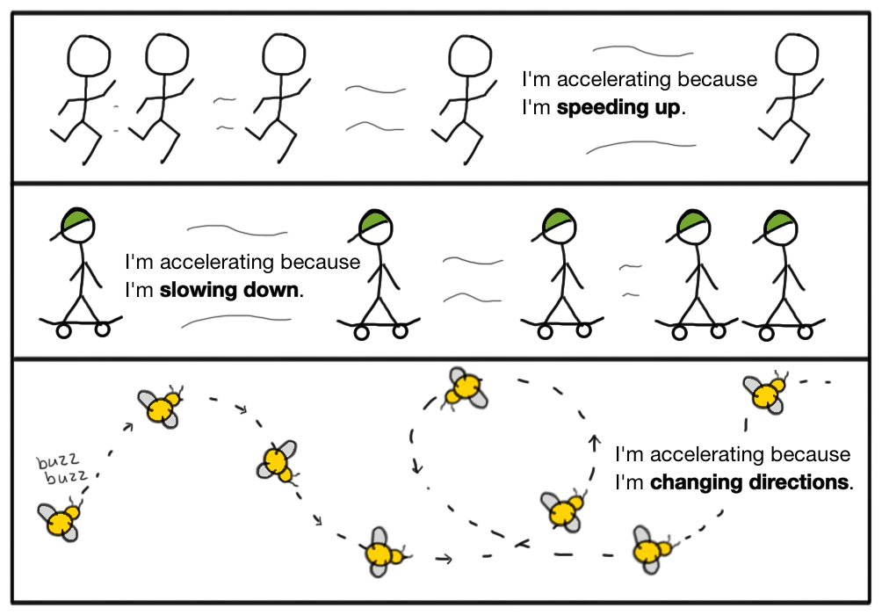
When you hear the word acceleration – you probably think of a car going faster or speeding up
Well, you are not entirely wrong
The definition of acceleration is:
Any change in Speed AND/OR Direction

Slide 4
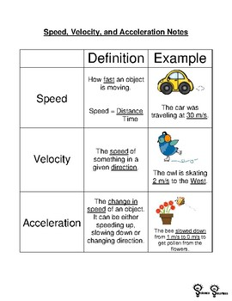
Review of Vocabulary words

Slide 5
Watch these videos
What is acceleration?→ Click ME (this one introduces the equation, but you can ignore it for now)
Review of Speed, Velocity, Acceleration → Click ME

Slide 6
Changes in Speed
Acceleration can be either increasing or decreasing
If a car is speeding up, that is acceleration
If a car is slowing down, that is deceleration
Both are considered acceleration, one is positive (speeding up) one is negative (slowing down)

Slide 7
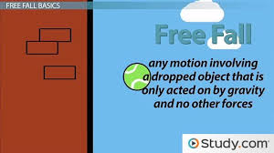
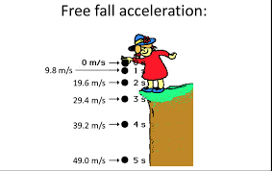
FreeFall
Another example of acceleration is freefall
Things fall because of gravity
The earth “pulls” things “down” because of its force
Gravity ALWAYS has the same velocity = 9.8 m/s

Slide 8
Constant Acceleration
When the velocity is the same (constant), this is considered constant acceleration
When a plane is traveling in a straight line, this is called constant acceleration

