Slide 1
Basics of Tissue Injuries

Slide 2
Objectives
Understand the difference between a strain vs. sprain
Identify the different types of soft tissue and bone injuries.

Slide 3
Soft Tissue Injuries
When a tissue is injured, it may bleed, become inflamed or swell.
Sprain- Overstretch or tear of a ligament
Strain- Overstretch or tear of a muscle or tendon

Slide 4
Categories of sprains and strains
First degree- Overstretched with no loss of function
Second degree- Partially torn, some loss of function and swelling
Third degree- Completely or nearly ruptured.

Slide 5
Names of soft tissue injuries
Incision
Abrasion
Contusion
Laceration
Avulsion
Amputation
Puncture
Contrecoup

Slide 6
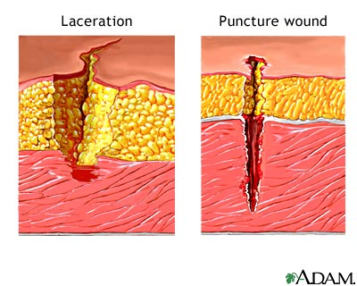
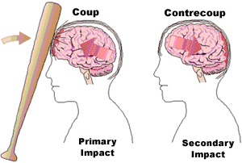

Slide 7

Muscular Injuries/Conditions
Muscle cramps- Painful, involuntary muscle contractions
Muscle guarding- Muscle contractions in response to pain

Slide 8
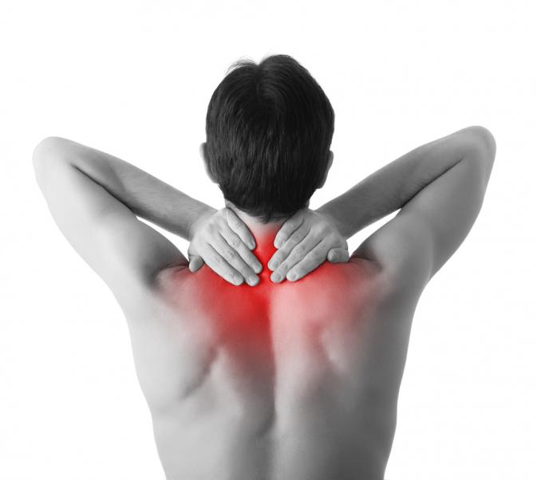
Muscle Injuries/Conditions
Muscle spasm- A reflex reaction caused by trauma to the musculoskeletal system
Muscle soreness- Pain caused by overexertion in exercise

Slide 9
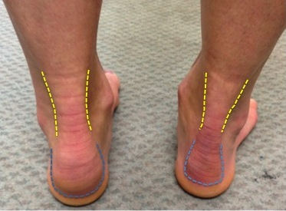
Tendon Injuries
Tendons attach muscles to bone.
Tendinitis- Inflammation of the tendon

Slide 10
Bone Injuries

Slide 11
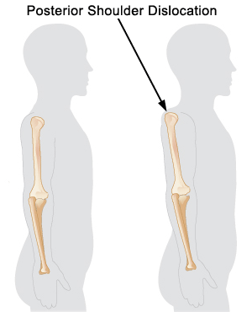
Types of Bone Injuries- Dislocation
Occurs when a force displaces a bone so the two ends of a joint do not align
Usually, they present with a noticeable deformity and pain.
A physician must reduce the injury.

Slide 12
Types of Bone Injuries- Fractures
A broken bone
Failure point- the amount of energy required to cause a break
Healing process- 6 to 8 weeks

Slide 13
Types of Fractures
Avulsion
Stress
Spiral
Longitudinal
Compression
Oblique
Comminuted
Transverse
Greenstick
Pathological
Blowout
Depressed
Epiphyseal

Slide 14
