Slide 1
Velocity
11.2 Part 2

Slide 2
Learning Goals
Define Velocity and give example
Compare Speed and Velocity
Compare Scaler and Vector quantities
Give examples of a vector
Combine Velocities

Slide 3
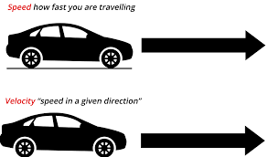
What is Velocity?
We just learned about Speed last week and how to calculate it
This week we will learn about Velocity

Slide 4
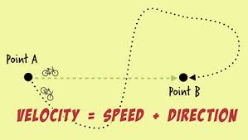
Velocity is speed AND direction combined
Now it matters not ony how fast you are going but also what direction you travels
Velocity is a vector (I know new word, we will discuss shortly
The following videos will show you the difference between speed and velocity - Click ME and ME

Slide 5
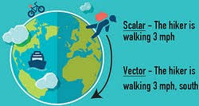
Vectors
So here is a new word – Vector
When we were measuring speed, we did not care about what direction we were going, so that was not considered a vector quantity
When we measure speed AND explain direction, there are 2 different pieces of information, that is known as a vector
This video does a very good job at explaining what a vector it (sorry about accent, but video is good) – Click ME

Slide 6
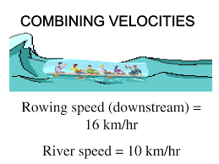
Combining Velocities
So now that you know what Velocity and Vectors are…..
Sometimes, an object will have more than one velocity – which means it goes in two different directions or speed
Watch this video – it does a very good job at
Explaining this concept – it is more lecture style but he does a good job making sense of it – Click ME

